Slide 1
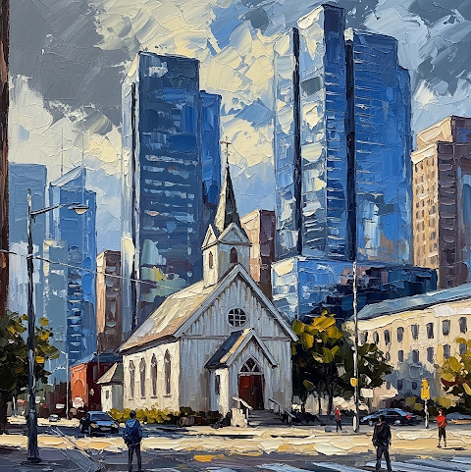





In-depth Plenary Sessions
Practical Workshops
Focused Discussions & Fellowship
Information & Registration at: aflchomemissions.org/conference/
Regional Conference
November 8, 2025
8:40 am – 3:00 pm
Emmaus Free Lutheran Church
Bloomington, MN
Mission Clarity: Renewing the Congregation for the Mission of God
Please RSVP for free lunch
Childcare Provided

